Slide 1




CROWD DETECTION IN A BUS —
REAL-TIME PASSENGER DETECTION & COUNTING USING YOLO OBJECT DETECTION
Submitted by
Dharan C
Anto X
Varun S
Guided by
S. Divya Bairavi, M.E., (Ph.D)
Assistant Professor
Department of CSE (AI & ML)

Slide 2
Abstract
Buses often get overcrowded, making travel uncomfortable and unsafe. This project builds a system that detects how crowded a bus is using photos.
A camera inside the bus captures a photo at regular intervals, and a YOLOv8 model (running on a Raspberry Pi) counts the passengers. Based on this count, the system classifies the crowd level as low, medium, or high.
The result is shown on a dashboard so authorities and passengers know how crowded a bus is — even before it arrives at the stop.
YOLOv8 nano is fast, accurate, and light enough for a low-cost device. Using photos instead of continuous video also reduces processing load.
Crowd Detection in a Bus
2

Slide 3
Introduction
Commuters can't judge how crowded a bus is until it actually arrives at the stop
By then it's too late to plan around it — wait for the next bus, or squeeze in anyway
Transit authorities have no live, low-cost way to monitor crowding across a fleet
Existing counting methods are either inaccurate (manual, basic sensors) or expensive (dedicated APC hardware)
Our approach: an in-bus camera + a lightweight YOLO model checks crowd level at every stop, automatically
The reading is pushed to a live dashboard — visible to commuters and to authorities planning routes
Designed to be affordable enough for an entire fleet, not just a pilot batch
Crowd Detection in a Bus
3

Slide 4
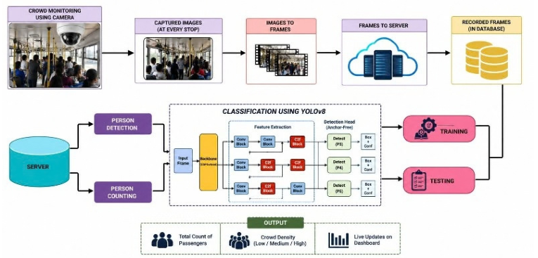
System Architecture
Crowd Detection in a Bus
4

Slide 5
Literature Review
Prior work spans IoT sensors, classical CV, and YOLO/CNN-based crowd detection — informing the choice of a lightweight edge model.
YEAR | AUTHORS | PAPER / METHOD | RELEVANCE TO THIS PROJECT
2021 | Ahmed, I. et al. | IoT crowd monitoring via SSD + MobileNetV2 (transfer learning) | Confirms a lightweight detector on constrained hardware is viable for real IoT deployments
2022 | Wang, S. et al. | Lightweight CNN (modified MobileNetV2) for crowd density estimation | Supports choosing a lightweight model family (YOLOv8 nano) for our Pi-based edge device
2023 | Khan, M.A. et al. | LCDnet — lightweight real-time crowd density model | Validates real-time, low-cost density estimation similar to our threshold-based classifier
2023 | Zhang, X. et al. | Crowd density mapping & classification via video + GIS | Precedent for turning raw counts into density classes, as our Low / Medium / High labels do
2024 | Qaraqe, M. et al. | PublicVision — secure surveillance using a Swin Transformer | Highlights the need for a secured backend / API, shaping our Flask authentication design
2024 | Arun, D.R. et al. | YOLO-GHOST — IoT-based smart crowd monitoring (camera + cloud dashboard) | Closest existing system; we trade its continuous-video + cloud pipeline for periodic photo capture on a ₹2,700 Pi per bus
REVIEW TAKEAWAY Prior systems prove YOLO-based detection and IoT dashboards work separately — this project combines both on the cheapest possible edge hardware, per bus.
Crowd Detection in a Bus
5

Slide 6
Literature Review — Research Gap
Application-specific: public transport crowd systems
Research gap identified
Surveys show IoT, deep learning, and WLAN-enabled mobile devices used together to estimate passenger counts and predict bus location
Reinforces a multi-sensor design — combining GPS with vision-based detection
Non-visual sensor systems (IR / WiFi) lack crowd-distribution detail
Heavy density-estimation CNNs are unsuitable for low-cost edge hardware
Most existing work stops at detection/counting accuracy — no live, commuter-facing output
OUR GAP
A lightweight YOLO-based head/person detector on edge hardware (Raspberry Pi), combined with GPS and threshold-based Low / Medium / High classification, pushed live to a commuter dashboard — balancing accuracy, cost, and real-time feasibility.
Crowd Detection in a Bus
6

Slide 7
Existing Systems
THE GAP IN WHAT'S OUT THERE
IR / WiFi sensors: give occupancy counts only, no visual validation or distribution detail
Classical CV methods: struggle with lighting, occlusion, and perspective distortion
Heavy YOLO / density-map CNNs: accurate, but too resource-intensive for low-cost edge hardware
Most stop at detection or counting — no live, commuter-facing crowd status
Depth-sensor or multi-camera setups push up hardware cost
No single system is both real-time and cheap enough for a whole fleet, not just a pilot
Crowd Detection in a Bus
7

Slide 8
Proposed System
WHAT'S NEW HERE
Lightweight YOLOv8 nano detector, tuned specifically for in-bus scenes
Runs directly on a low-cost Raspberry Pi Zero 2 W — no cloud dependency for inference
Converts passenger count into a Low / Medium / High crowd classification
Pushes live status to a commuter-facing dashboard, in addition to authorities
No extra depth sensors, WiFi rigs, or multi-camera setups — a single camera is enough
Full hardware cost ≈ ₹2,700 per bus — affordable across an entire fleet
Crowd Detection in a Bus
8

Slide 9
06 · HARDWARE
Hardware Requirements
Camera Module — ₹350
  OV2640 / low-cost USB camera for photo capture
Processing Unit — ₹1,500
  Raspberry Pi Zero 2 W, runs YOLO inference on-device
Stop Trigger — ₹150
  IR / ultrasonic sensor signals a photo capture at each stop
MicroSD Card — ₹300
  16GB Class 10, stores OS, model weights & photos
Power Supply — ₹150
  12V→5V buck converter, powered off the bus line
Enclosure — ₹250
  3D-printed / acrylic housing to protect the camera & Pi
EST. TOTAL COST / BUS
₹2,700
a fraction of the cost of a dedicated Automatic Passenger Counter
Crowd Detection in a Bus
9

Slide 10
Software Specification
Detection Model
YOLOv5 / YOLOv8 nano (Ultralytics) for real-time object detection
Programming Language
Python, for model inference and system logic
Computer Vision Library
OpenCV, for photo capture and pre-processing
Backend Framework
Flask, serving the REST API for detection results
Database
MySQL / SQLite for count and crowd-status records
Operating System
Raspberry Pi OS for on-device deployment
Crowd Detection in a Bus
10

Slide 11
Methodology
1
Trigger
2
Capture
3
Detection
IR / ultrasonic sensor detects the bus arriving at a stop and triggers a capture
In-bus camera takes a photo of the passenger area
YOLOv8 nano runs on the Raspberry Pi to detect and count passengers
4
Classification
5
Storage
6
Live Update
Passenger count is mapped to a Low / Medium / High crowd threshold
Record is verified by the Flask API and stored in the SQL database
Dashboard queries the latest record and refreshes crowd status for commuters and authorities
Crowd Detection in a Bus
11

Slide 12
Implementation
Python environment setup
YOLOv8 model setup
Person detection and counting
Live camera integration
Flask web dashboard
Crowd-level classification
Camera
OpenCV
YOLOv8
Count
Crowd Level
Dashboard
Crowd Detection in a Bus
12

Slide 13
YOLOv8 Person Detection
YOLOv8 nano is used for real-time object detection.
The model identifies person objects in the input frame.
Bounding boxes are drawn around detected people.
The detected persons are counted.
The count is used for crowd-level classification.
Input Frame
YOLOv8
Person Boxes
Person Count
Crowd Detection in a Bus
13

Slide 14
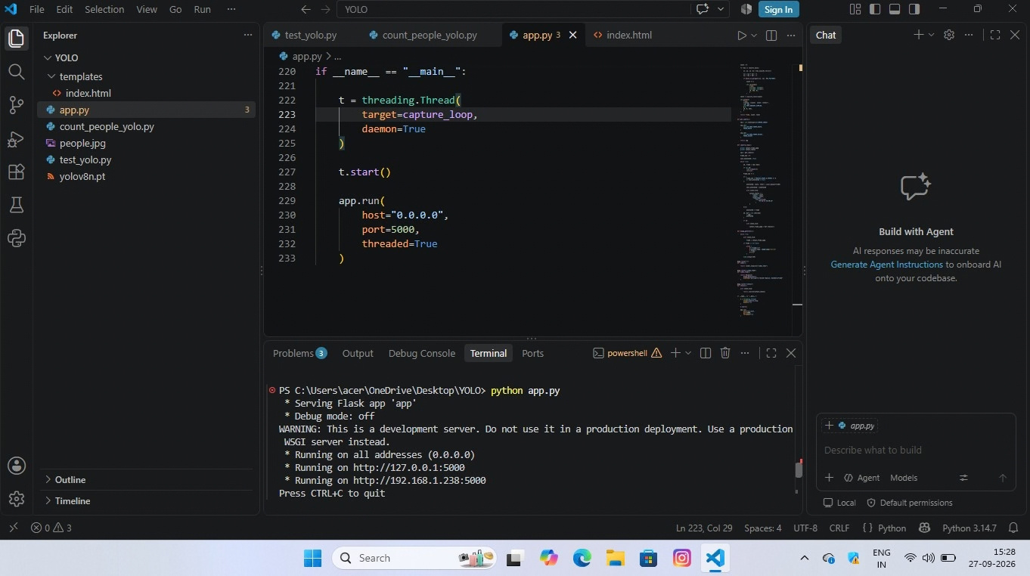
Code Implementation
Crowd Detection in a Bus
14

Slide 15
Live Camera Implementation
OpenCV is used to capture the live camera feed.
The current prototype uses the laptop webcam for testing.
Camera frames are continuously captured.
YOLOv8 processes the frames to detect people.
The detection result is displayed as a live video.
Camera
OpenCV Video Capture
YOLOv8 Detection
Live Output
Crowd Detection in a Bus
15

Slide 16
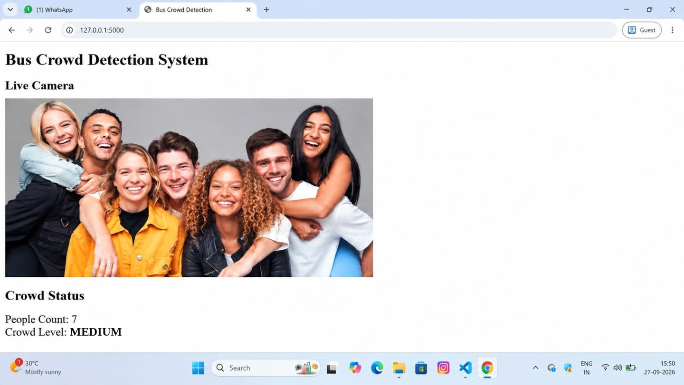
Flask Web Dashboard
Flask provides the web interface for the detection system.
The dashboard displays the live camera feed.
People count and crowd level are updated automatically.
Main routes: /, /video_feed and /status.
A simple interface for viewing results.
YOLO Detection
Count
Classification
Flask Web Dashboard
Crowd Detection in a Bus
16

Slide 17
Crowd Level Classification
The detected passenger count is converted into a crowd level.
LOW
MEDIUM
HIGH
0–30
31–55
56 or more
people
people
people
Example: a detected count of 40 is classified as MEDIUM.
Crowd Detection in a Bus
17

Slide 18
Implementation Results
YOLOv8 model successfully loaded and tested.
Person detection and counting were implemented.
Live webcam feed was successfully tested.
Flask dashboard was implemented.
People count and crowd level are displayed on the webpage.
CURRENT PROTOTYPE
Camera
YOLOv8
Person Count
Crowd Level
Flask Dashboard
Crowd Detection in a Bus
18

Slide 19
Next Implementation Stage
Connect a camera to Raspberry Pi Zero 2 W.
Deploy the YOLOv8 model on the Raspberry Pi.
Test the system with an actual bus camera view.
Tune the crowd-level thresholds for the bus environment.
Deploy the live dashboard for monitoring.
Bus Camera
Raspberry Pi
YOLOv8
Flask
Live Dashboard
Crowd Detection in a Bus
19

Slide 20
JULY – AUGUST · WEEKS 1–8
Project Timeline — Gantt Chart
ACTIVITY
JULY
AUGUST
W1
W2
W3
W4
W1
W2
W3
W4
Problem Identification & Planning
Literature Survey
Requirements & System Design
YOLOv8 Setup & Dataset Preparation
Person Detection Implementation
Live Camera Integration
Flask Web Dashboard
Testing & Crowd Classification
Results, Documentation & Review
Planned project activity
Crowd Detection in a Bus
20

Slide 21
SEPTEMBER – OCTOBER · WEEKS 9–16
Project Timeline — Gantt Chart
ACTIVITY
SEPTEMBER
OCTOBER
W1
W2
W3
W4
W1
W2
W3
W4
Problem Identification & Planning
Literature Survey
Requirements & System Design
YOLOv8 Setup & Dataset Preparation
Person Detection Implementation
Live Camera Integration
Flask Web Dashboard
Testing & Crowd Classification
Results, Documentation & Review
Planned project activity
Crowd Detection in a Bus
21

Slide 22
Conclusion
Overcrowding on public buses affects passenger comfort, safety, and transit efficiency. This project built a real-time crowd detection system using a camera and YOLOv8 nano, designed for a low-cost Raspberry Pi Zero 2 W.
Photos captured at regular intervals are processed on-device to count passengers and classify crowd levels as low, medium, or high, with results pushed through a Flask backend to a live dashboard for commuters and authorities.
Periodic photo capture instead of continuous video keeps processing light for embedded hardware while still delivering timely updates — affordable and practical across an entire fleet, not just a pilot batch.
A simple camera setup with a lightweight deep learning model can meaningfully improve route planning and passenger experience — a scalable foundation for smarter, data-driven public transportation.
22

